Slide 1


Case Study: Drupal gets smarter with AI driven Bot

Slide 2
Twitter: @kamalpreetkaur
Linkedin: /in/kamalpreetkaurrajpal
Email: kamalpreet.kaur@srijan.net

Slide 3
Case Study | Introduction
Leveraging Amazon Lex to build enterprise chatbots that serve a diverse range of use cases for a large cleaning solutions enterprise
24x7
Access to data from anywhere
$90M
Upsell of products
42%
User retention increased

Slide 4
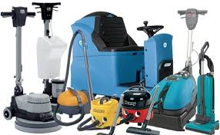
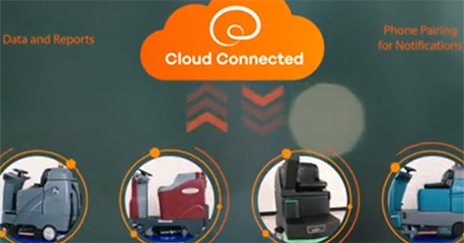
Case Study | About Customer
One of the biggest Global cleaning solutions Co offering industrial cleaning and hygiene chemicals.
Manufacture the cleaning machinery, and do equip them with IoT sensors that transmit performance data

Slide 5
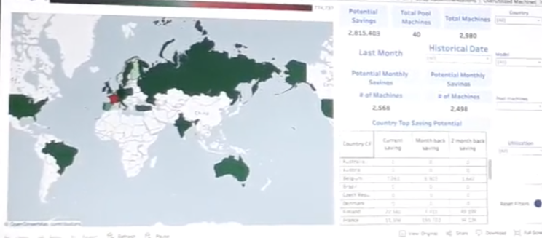
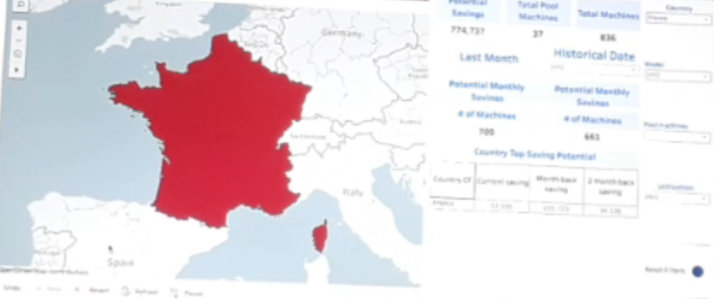
Case Study | Project Requirement
Onboard assets to the IoT ecosystem, collect, monitor, & analyze sensor data from various customer locations.
Create interactive data visualization dashboards that presented all this data, and allowed client stakeholders, and their customers, to analyze it in real time.

Slide 6
Case Study | Key Metrics
This is a Fleet tracking solution helping monitor your fleets
Total asset management—monitor your fleet remotely 24/7
Check activity of specific machines
Check Machines which are in Pool
Overutilized Machines

Slide 7
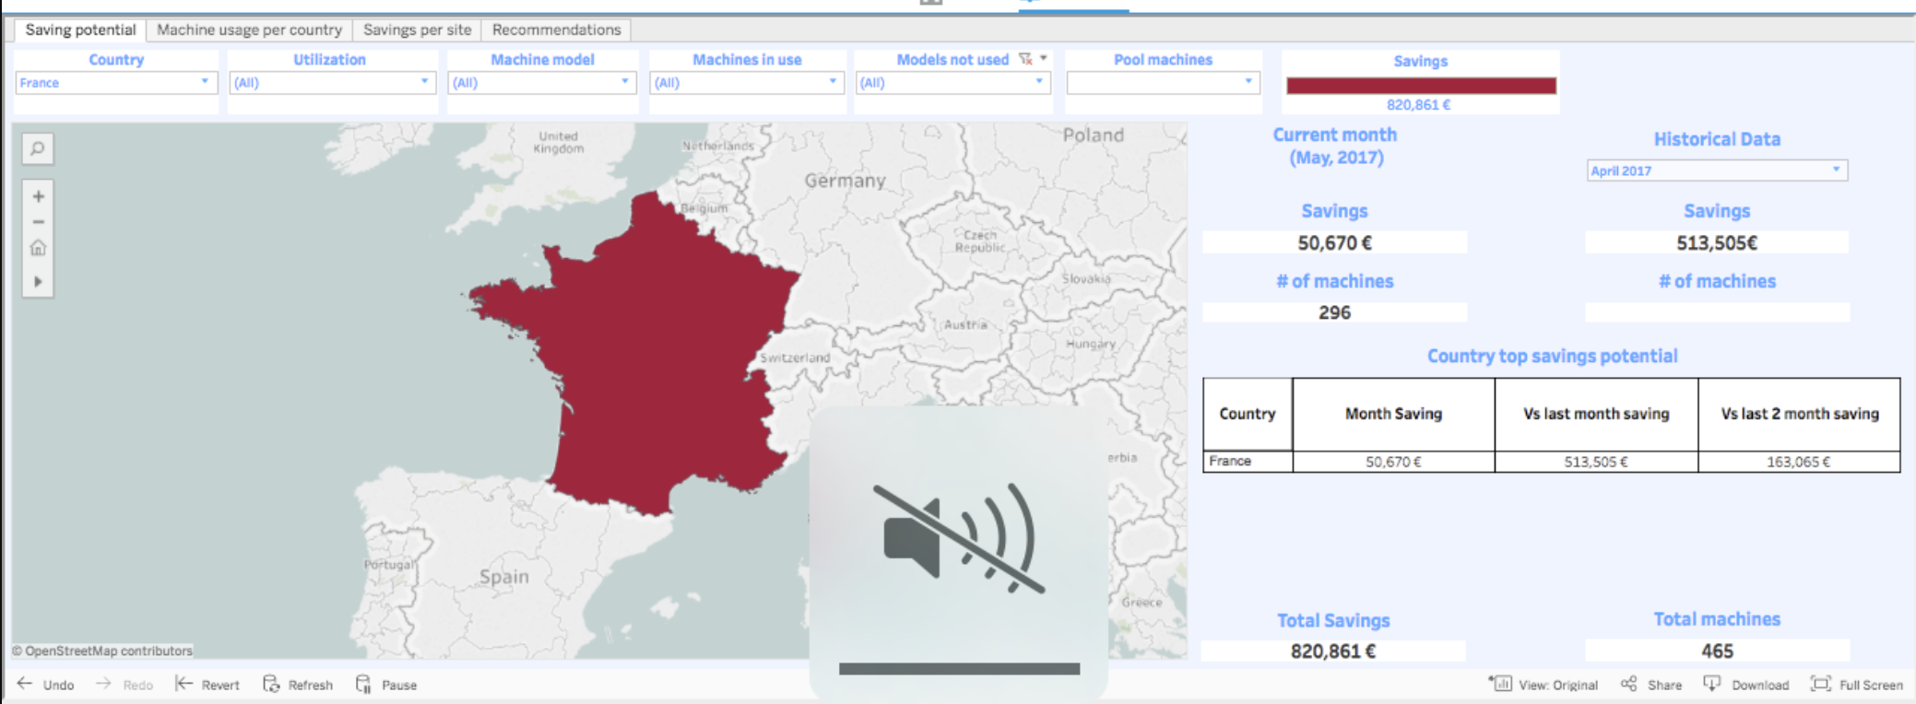
Case Study | Dashboards

Slide 8
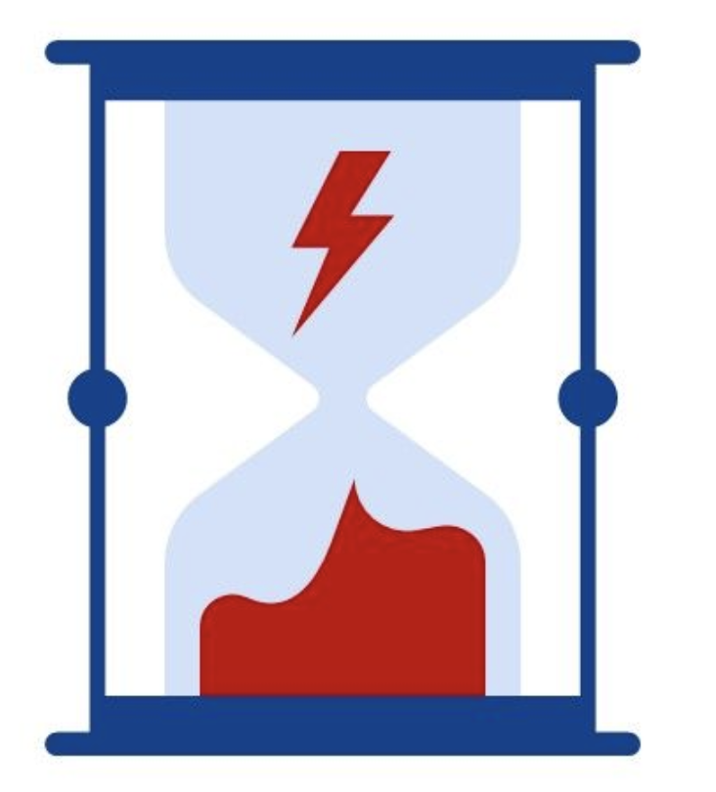
Case Study | Project Challenges
While the dashboards were a great resource, they had a few drawbacks:
They required a log-in and were not always remotely accessible
There was lot of time and effort involved in finding the right data in the dashboard

Slide 9

Case Study | Why Chatbots
Creating anytime, anywhere access to enterprise data visualization dashboards via chatbots.
Chatbots that carry out complex analysis of dashboard data to deliver concise answers to questions asked.
Chatbots automated several operational tasks within the enterprise

Slide 10
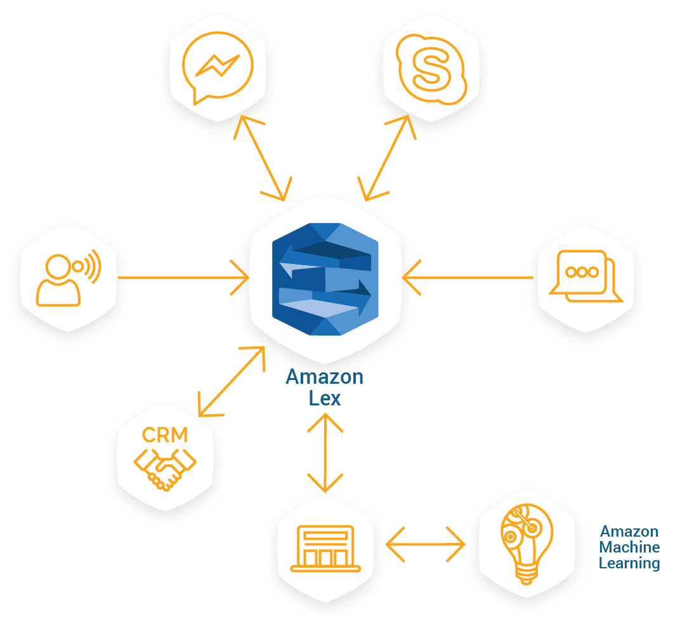
Case Study | Build once consume anywhere
Leverage Amazon Lex (Alexa NLP engine and voice synthesis)
Can be consumed by voice over phone, Social Messengers and Mobile based apps.
Extensible to other future platforms.
Uses machine learning to make the bot ask intelligent questions -- Learn from user response.

Slide 11



Case Study | Chatbot Maturity
Transactional
Guides the user through a series of steps to complete a task and can integrate customer data
Personalized
Presents user specific responses by connecting to enterprise systems and clarifies user intent using menus or simple questions
Informational
Understands natural language to provide answers to the questions posed
Understanding
Emulates human conversation and understands context to complete transaction Executes transaction on behalf of users Handles complex intents Expedites resolution through proactive service
Natural language maps user request to simple intent Intent maps to the best response in the content database
Personalized responses include results from backend systems (eg, CRM) Clarifies user intent using menus or simple questions
Engagement

Slide 12
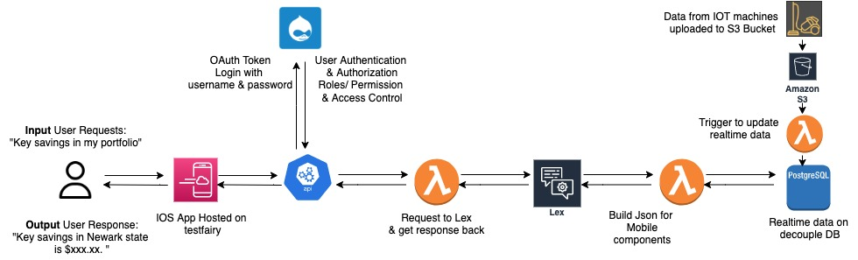
Case Study | Technical Architecture

Slide 13
Case Study | Business Benefits
The bots ecosystem helped the client close (upsell) business worth of 90 million USD
One of the bots increased the user retention of the beta user group from 8% to 42%, which allowed the sales team to upsell more of the products.
The bot applications allowed the analytics team to automate a lot of tasks happening over spreadsheets.

Slide 14
Questions ??
Head Offices
2430 Highway 34
Building B, Suite 22
Manasquan, NJ 08736, USA
8D Vandana Building, Tolstoy Marg,
New Delhi 110001, INDIA
email: business@srijan.net
web: srijan.net
twitter: @srijan

